Slide 1

Making this resource work for you
Prior to teaching this lesson, please refer to the ‘Unit Overview and Planning Document’.
Further guidance on planning Science Mastery lessons can be found in the detailed planning guidance document.
Refer to the ‘notes’ section on each slide for useful information, including suggested expositions, pedagogical content knowledge, suggested questions, answers and more. Consider using presenter mode so you can see this guidance throughout the lesson.
The introduction slides can be adapted to suit your teaching style and the needs of your class.
Before the lesson, adapt the fix-it slide to address any misconceptions identified in the previous lesson’s exit ticket.
Choose from the suggested activities to suit your class. The intention is not that you complete all of these, but that you select those which ones are most appropriate for your students. It may be appropriate to further adapt activities for your students.
These lessons are designed to occupy approximately 1 hour. To adapt for a shorter or longer lesson duration we advise you to adapt the activity section accordingly.
Please consider using the final slide to send feedback about this lesson or examples of PowerPoints that you have adapted to our design team. Your feedback is used to improve Science Mastery for all of our teachers and students. We appreciate all suggestions and comments.
Thank you for reading!
The Science Mastery Team

Slide 2

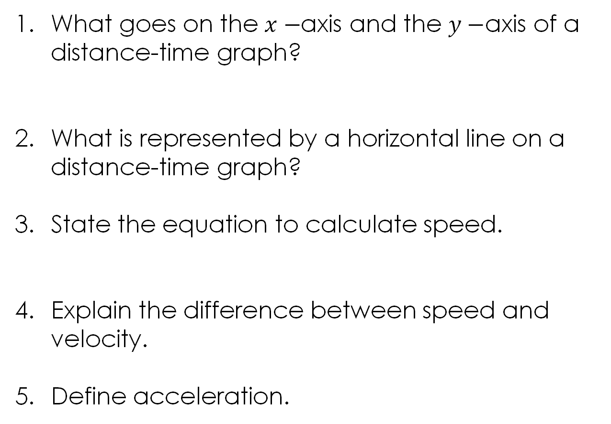

Velocity-Time Graphs
Answer the following questions:
What goes on the $x−$axis and the $y−$axis of a distance-time graph?
What is represented by a horizontal line on a distance-time graph?
State the equation to calculate speed.
Explain the difference between speed and velocity.
Define acceleration.
Time goes on the $x−$axis and distance goes on the $y−$axis.
A stationary object (not moving, speed = 0 m/s)
$$Speed= \frac{Distance}{Time}$$
Velocity is speed in a given direction.
The rate of change of velocity.
Notes:
Foundation question: State the SI units for speed, distance, time and velocity.
Answer: Speed is m/s, distance is m, time is s and velocity is m/s.
Stretch question: Describe the motion shown in the above distance-time graph.
Answer: The object is moving with a constant speed for 5 seconds, then it stops for 5 seconds, travels at a slower constant speed for 5 seconds

Slide 3
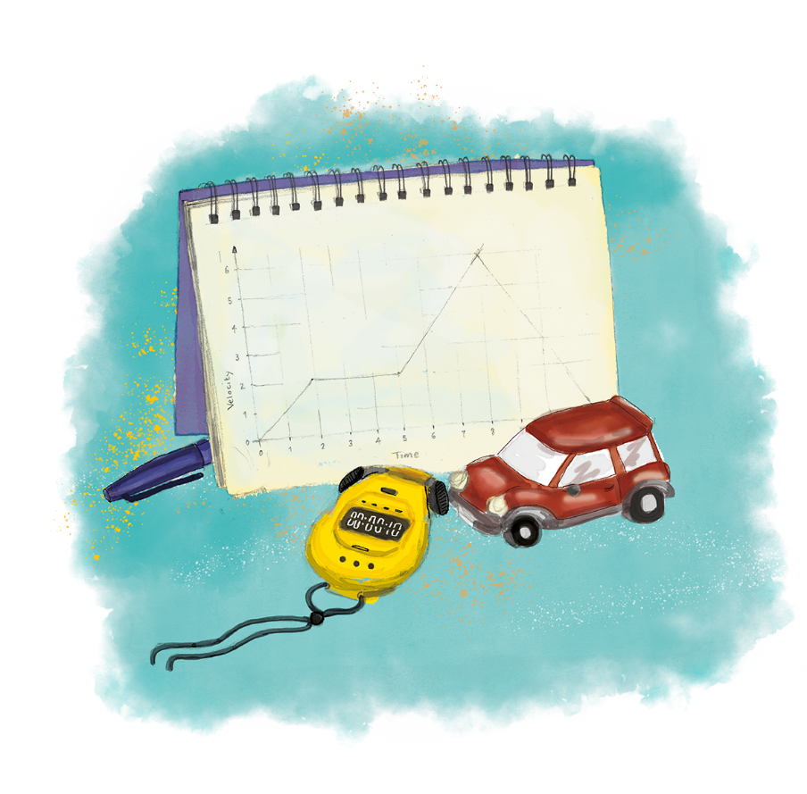


P3.1.9
20/10/2025
Velocity-Time Graphs
P3.1.1 Prior Knowledge Review
P3.1.2 Scalars and Vectors
P3.1.3 Resultant Vectors
P3.1.4 Resolving Vectors
P3.1.5 Newton's Third Law
P3.1.6 Newton's First Law
P3.1.7 Acceleration
P3.1.8 Acceleration Investigation
Maths in Science Lesson 17
P3.1.9 Velocity-Time Graphs
P3.1.10 Velocity-Time Graphs 2
P3.1.11 Acceleration Problems
Notes:
In P2.1 pupils covered distance-time graphs. This lesson starts with a brief recap of distance-time graphs before moving onto velocity-time graphs and being able to compare the features of both. In the next lesson pupils will look at more advanced features of velocity-time graphs and further consolidate their understanding of the relationships between forces and motion.
Hook:
Start pupils with the talk task as they come in to recap the features of a distance-time graph.

Slide 4

Following this lesson, students will be able to:
Describe motion using velocity-time graphs.
Calculate acceleration from a velocity-time graph.
Calculate the area beneath the graph to determine distance travelled.
Key Words:
velocity
acceleration
slope
gradient
area
distance

Slide 5
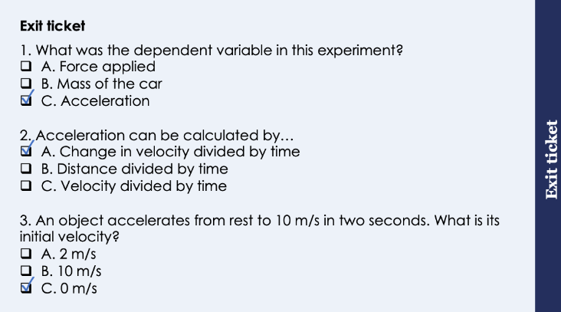
This is the fix-it portion of the lesson
The fix-it is an opportunity to respond to gaps in knowledge, especially those identified by the previous lesson’s exit ticket.
The teacher should customise this slide as needed, to facilitate
reteach, explanation, demonstration or modelling of ideas and concepts that students have not yet grasped or have misunderstood.
practise answering specific questions or of key skills.
redrafting or improving previous work.
Notes:
Suggested Guidance from previous exit ticket:
Q1. Answer: C
If students answer A or B they are still not secure on the difference between independent and dependent variables. To fix-it, you may want to revisit earlier skills lessons on variables to get pupils to identify dependent and independent variables from investigation titles.
Q2. Answer: A
If students answer B they have confused acceleration and speed. If students answer C they are closer but have missed the crucial detail of change in velocity. To fix-it, get pupils to explain how you calculate the change in a quantity and how this applies to acceleration.
Q3. Answer: C
If students answer A they have taken the time as the initial velocity and if students answer B they have taken final velocity as the initial velocity. To fix-it, model further examples with pupils, highlighting or underlining the quantities from the question.

Slide 6
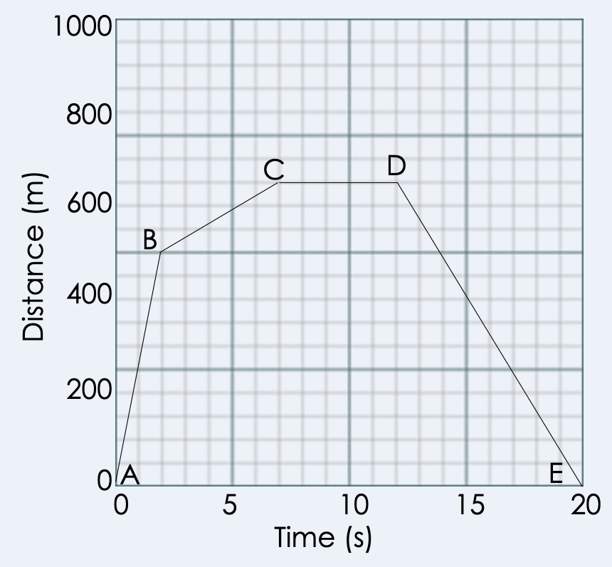
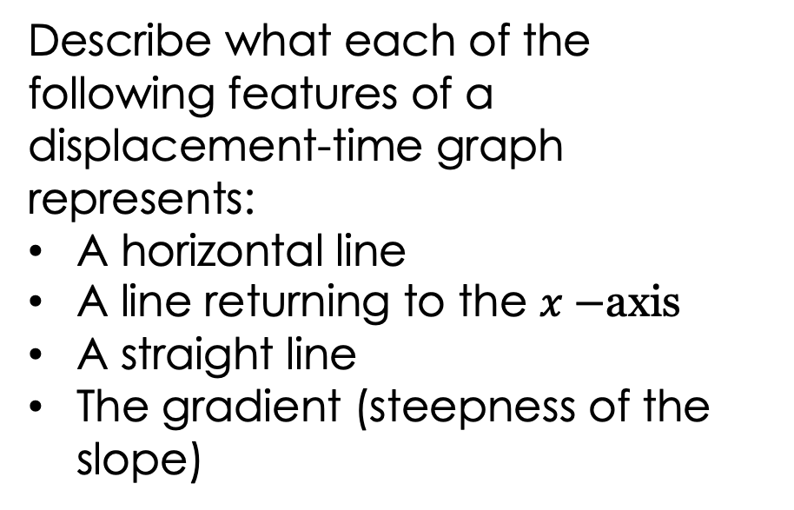
Distance/Displacement-Time Graphs Review
Describe the motion shown by this displacement-time graph.
Describe what each of the following features of a displacement-time graph represents:
A horizontal line
A line returning to the $x−$axis
A straight line
The gradient (steepness of the slope)
Displacement (m)
Notes:
Guidance:
Pupils have reviewed distance-time graphs in the prior knowledge review lesson but you may want to use this review before the introduction of velocity-time graphs so pupils can more easily compare them.
The key new thing here is that students have looked at distance-time graphs but this graph uses displacement on the y-axis, which is why we can have the line returning to the start position.
Suggested points:
A to B:the object is moving at a quick constant speed, covering 500 metres in 2 seconds.
B to C: the object is moving at a slower constant speed, covering 150 metres 5 seconds.
C to D: the object is stationary (speed = 0 m/s, no distance is covered in 5 seconds).
D to E: the object returns to its original position, at a speed between AB and BC.
Describe what each of the following features of a displacement-time graph represents:
A horizontal line - a stationary object
A line returning to the $x−$axis - an object returning to its starting point
A straight line - an object travelling with constant speed
The gradient (steepness of the slope) - the speed of an object
*As this line returns to the x-axis it should be ‘distance from start’ or displacement rather than just distance.
Suggested guidance:
Talk tasks can be used in a variety of ways to suit the particular needs of the students you are teaching. Through exchanging views with others, students develop their understanding of the science beyond what could be achieved individually.
Science classrooms that successfully integrate talk have the following features:
Science talk is a regular feature of lessons and is woven into classroom activities.
Students are paired or grouped strategically by the teacher to ensure productive interaction. This might take into consideration the students’ proficiency of the English language, how encouraging they might be to peers and their attainment in the topic. It’s a good idea to consider these pairings in the class seating plan.
Students are encouraged and supported to talk, but are not forced to talk.
The teacher should take on the role of a facilitator, engaging with conversations where necessary and encouraging or steering the conversation where needed.
Students are encouraged to use the language they have to express their ideas (e.g., everyday language, imperfect English, native language), but also to incorporate science specific terminology where this is more accurate or has been taught.
6. Scientifically inaccurate ideas are not dismissed by the partner or teacher; open discussion and further investigation are relied on to help students construct ideas that support them to progress in their scientific understanding.
7. Guidelines for behaviour during talk tasks are explicit and frequently reviewed. Rules for students might be:
Listen carefully to your partner
Take turns talking.
Speak one at a time, without interrupting.
Politely agree or disagree and explain why.
Politely point out if your partner has used a scientific word incorrectly, if they have explained the science incorrectly, or if there is a more accurate way to describe something.
If confused, ask questions.
Stay focused on the discussion topic.
Respond to one another.

Slide 7
Velocity-Time Graphs
Velocity-Time graphs can be used as well as distance-time graphs to describe the motion of an object.
Time is recorded on the x axis and velocity is recorded on the y axis.
Increasing velocity (constant acceleration)
Constant velocity
Decreasing velocity (constant deceleration)
Constant velocity
Notes:
Exposition Type: Explanation
Suggested Exposition:
Distance-time graphs are a useful way to represent the journey of an object, but we can also represent the journey of an object using a velocity-time graph. These are very similar to distance-time graphs, but instead of distance on the y-axis, they have velocity on the y-axis. As they have velocity rather than distance on the y-axis, this means that the features of a velocity-time graph are different to on a distance-time graph.
What does a horizontal line represent on a distance-time graph?
A stationary object, speed = 0 m/s because no distance is covered.
On a velocity-time graph, a horizontal line represents a constant velocity.
Reveal constant velocity.
Using this graph as an example we can see the first horizontal line runs along at 5. This means that the object has a constant velocity of 5 m/s for the first 5 seconds.
What does a positive gradient represent on a distance-time graph?
An object with constant speed. The same distance is covered during each time interval.
Reveal increasing velocity (constant acceleration).
On a velocity-time graph, a positive gradient represents an object with a constant positive acceleration. This means that the velocity of the object is increasing by the same amount during each time interval.
Then we have another horizontal line.
What does this mean?
Constant velocity.
How is this different to a distance-time graph?
On a distance-time graph a horizontal line represents a stationary object (which does have a constant velocity, it is just 0 m/s).
What does a negative gradient represent on a distance-time graph?
An object returning to its starting point. Technically this should be on a displacement-time graph as you cannot have 0 distance being covered in total if there has been distance covered, but you can have a displacement of 0, which just means the object is in the same position as it started.
Reveal decreasing velocity (constant deceleration).
On a velocity-time graph, a negative gradient represents an object with a constant negative acceleration, which we can also call a deceleration. This means that the velocity of the object is decreasing by the same amount during each time interval.

Slide 8

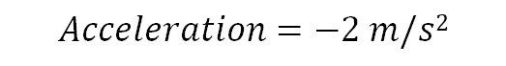





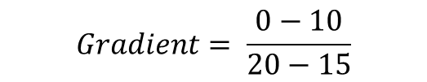
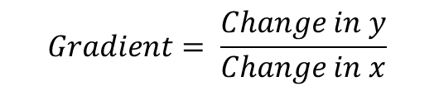
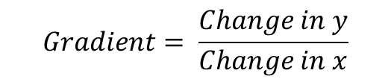
Velocity-Time Graphs
$$Gradient= \frac{Change in y}{Change in x}$$
$$Gradient= \frac{0−10}{20−15}$$
$$Gradient= \frac{Change in y}{Change in x}$$
$$Gradient= \frac{−10}{5}$$
$$Gradient= \frac{10−5}{10−5}$$
$$Gradient=− 2$$
$$Gradient= \frac{5}{5}$$
$$Acceleration=−2 m/s2$$
$$Gradient=1$$
$$Acceleration=1 m/s2$$
Notes:
Exposition Type: Explanation
Suggested Exposition:
What can we calculate from the gradient (slope) of a distance-time graph?
Speed. This is a measure of how much distance is covered per unit time.
On a velocity-time graph we can use the gradient to calculate the acceleration of an object. Acceleration is the rate of change in velocity so if we know the change in velocity and how long this took, we can calculate the acceleration.
Gradient = change in y/change in x
The gradient of a horizontal line is 0, which is constant velocity (speed and direction are not changing) because there is no change in y.
Let’s calculate the acceleration between 5 and 10 seconds.
The acceleration can be calculated using the gradient of the line.
Gradient = change in y/change in x
Gradient = (10-5)/(10-5)
Gradient = 1
As the gradient is 1, this means the acceleration during this time is 1 m/s². If an explicit direction is not given, we can assume that the object is moving forwards.
Let’s calculate the acceleration between 15 and 20 seconds. Remember, even though the velocity is decreasing, acceleration is a change in velocity so this is still an acceleration, just a negative one.
The acceleration can be calculated using the gradient of the line.
Gradient = change in y/change in x
Gradient = (0-10)/(20-15)
Gradient = -2
As the gradient is -2, this means the acceleration during this time is -2 m/s². As we have used a positive acceleration to mean forwards, this has a negative acceleration so it means that this acceleration is acting in the opposite direction.

Slide 9
Velocity-Time Graphs
The distance travelled can be determined by calculating the area under the graph.
This may involve splitting the area under the graph into rectangles and triangles.
Notes:
Exposition Type: Explanation
Suggested Exposition:
Another feature of velocity-time graphs we can use is the area under the graph. If we calculate the area under the graph, this tells us the total distance travelled by the object during the time. If the object just travelled at a constant velocity it would just be a case of calculating the area of a triangle but in most velocity-time graphs, the velocity changes. This means that to calculate the area under the graph we may need to split the area up into rectangles and triangles. There are multiple ways to do this so it’s important to mark on the shapes that you use so that you are including the whole area. Other people might use a different method, or a different combination of triangles and rectangles but you should still end up with the same final answer.
Distance travelled = area under the graph
How do you calculate the area of a rectangle?
Area of a rectangle = base x height
How do you calculate the area of a right-angled triangle?
Area of a right angled triangle = ½ x base x height
Let’s calculate the distance travelled by this object.
Area 1:
A = bh
A = 5 x 5
A = 25
Area 2:
A = bh
A = 5 x 5
A = 25
Area 3:
A = ½bh
A = 0.5 x 5 x 5
A = 12.5
Area 4:
A = bh
A = 5 x 10
A = 50
Area 5:
A = ½bh
A = 0.5 x 5 x 10
A = 25
Total area = 25 + 25 + 12.5 + 50 + 25
Total area = 137.5
This means that during this time period, the object travelled a distance of 137.5 m.
For more able pupils it may help their understanding to explain why this is the case:
Velocity = speed in a given direction (in this case it is all in a positive direction so we assume it is the same direction)
Distance = Speed x Time (change in y multiplied by change in x)

Slide 10
Determine if the following statements are true or false for a Velocity-Time Graph:
Velocity goes on the x axis and time goes on the y axis
A horizontal line means that an object is stationary
A positive gradient means that an object is accelerating
A negative gradient means that an object is returning to its original position
False
False
True
False
Notes:
Purpose: review of new information.
false – time on x axis and velocity on y axis
false – this would be the case on a distance-time graph but on a velocity-time graph the horizontal line indicates constant speed (gradient = 0, therefore no acceleration)
True
False – this would be the case for the distance-time graph but on a velocity-time graph this means an object is decelerating (slowing down)

Slide 11




Which statements do you agree with?
I think that velocity and acceleration are the same
I think that negative acceleration values are incorrect
Distance can only be calculated with a separate distance-time graph
I think that the gradient of a line can indicate the acceleration
Notes:
Guidance: Pupils can discuss in pairs or small groups if each statement is correct or incorrect to draw out any misconceptions.
Blue: incorrect - negative acceleration values are deceleration (slowing down)
Yellow: incorrect - both are vector quantities but velocity is speed in a given direction and acceleration is how quickly the velocity changes.
Green: incorrect - distance can be calculated using the area under the graph
Pink: correct - gradient is the slope of the graph/change in velocity, which is acceleration
Suggested guidance:
Talk tasks can be used in a variety of ways to suit the particular needs of the students you are teaching. Through exchanging views with others, students develop their understanding of the science beyond what could be achieved individually.
Science classrooms that successfully integrate talk have the following features:
Science talk is a regular feature of lessons and is woven into classroom activities.
Students are paired or grouped strategically by the teacher to ensure productive interaction. This might take into consideration the students’ proficiency of the English language, how encouraging they might be to peers and their attainment in the topic. It’s a good idea to consider these pairings in the class seating plan.
Students are encouraged and supported to talk, but are not forced to talk.
The teacher should take on the role of a facilitator, engaging with conversations where necessary and encouraging or steering the conversation where needed.
Students are encouraged to use the language they have to express their ideas (e.g., everyday language, imperfect English, native language), but also to incorporate science specific terminology where this is more accurate or has been taught.
6. Scientifically inaccurate ideas are not dismissed by the partner or teacher; open discussion and further investigation are relied on to help students construct ideas that support them to progress in their scientific understanding.
7. Guidelines for behaviour during talk tasks are explicit and frequently reviewed. Rules for students might be:
Listen carefully to your partner
Take turns talking.
Speak one at a time, without interrupting.
Politely agree or disagree and explain why.
Politely point out if your partner has used a scientific word incorrectly, if they have explained the science incorrectly, or if there is a more accurate way to describe something.
If confused, ask questions.
Stay focused on the discussion topic.
Respond to one another.

Slide 12
Drill
On a distance-time graph what does the gradient show? On a distance-time graph what does the horizontal line show? On a distance-time graph a downwards line that reaches the X axis shows...
On a velocity-time graph what does a positive gradient show? On a velocity-time graph what does a negative gradient show? On a velocity-time graph what does a horizontal line show when it is above the y-axis? On a velocity-time graph a horizontal line at 0 on the y-axis shows... How do you calculate acceleration on a velocity time graph? If a gradient on a velocity time graph is calculated to be negative, what does this tell you about the acceleration? What are the units for acceleration?
Notes:
Purpose: This is a knowledge drill. The purpose of this is to check that the critical knowledge is secure before pupils move onto independent practice.
Suggested guidance: There are a range of ways this could be done depending on time and ability range of the class:
Mini whiteboards
As full sentences in exercise books
As short answers in exercise books
In the pupil workbook
As pair talk
As cold call

Slide 13
Drill answers
The gradient on a distance-time graph shows the velocity. The horizontal line on a distance-time graph tells you that the object is stationary. Like A downwards line that reaches the x-axis on distance-time graph shows that the object has returned to its original position. A positive gradient on a velocity-time graph shows acceleration.
A negative gradient on a velocity-time graph shows deceleration. A horizontal line that reads a number more than 0 on the y-axis of a velocity-time graph shows constant velocity. A horizontal line at 0 on the y-axis of a velocity-time graph tells you that the object is stationary.
You can calculate the acceleration on a velocity-time graph by finding the gradient. If the gradient on a velocity-time graph is negative, then this shows deceleration. The units for acceleration are m/s².
Notes:
Purpose: This is a knowledge drill. The purpose of this is to check that the critical knowledge is secure before pupils move onto independent practice.
Suggested guidance: There are a range of ways this could be done depending on time and ability range of the class:
Mini whiteboards
As full sentences in exercise books
As short answers in exercise books
In the pupil workbook
As pair talk
As cold call

Slide 14
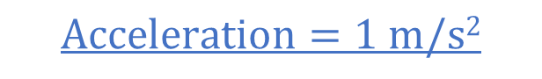


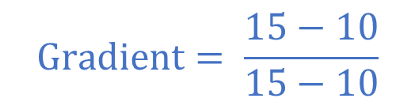
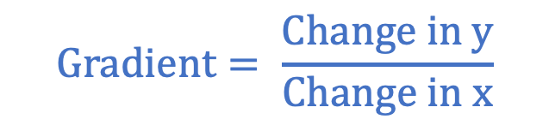
I: Interpreting velocity-time graphs
Calculate the acceleration between 10 and 15 seconds.
$$Gradient= \frac{Change in y}{Change in x}$$
$$Gradient= \frac{15−10}{15−10}$$
$$Gradient= \frac{5}{5}$$
$$Gradient=1$$
$$Acceleration=1 m/s2$$

Slide 15

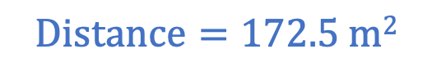
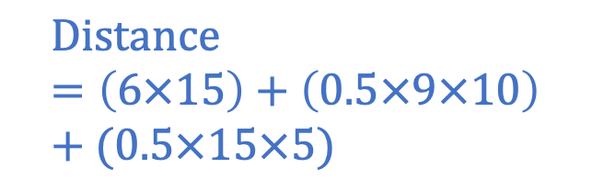


We: Interpreting velocity-time graphs
Calculate the distance travelled by this object.
B
$$Distance=area under the graph$$
c
$$Distance=A+B+C$$
$$Distance=\left(6×15\right)+\left(0.5×9×10\right)+(0.5×15×5)$$
$$Distance=90+45+37.5$$
A
$$Distance=172.5 m2$$
Notes:
The distance travelled in the area under the graph. Students can choose where to lay rectangles and triangles for this. However, the above is the most simplest

Slide 16










You: Interpreting velocity-time graphs
Use calculations to show that the object is accelerated at the same rate as it decelerated.
$$Gradient= \frac{Change in y}{Change in x}$$
$$Gradient= \frac{Change in y}{Change in x}$$
$$Gradient= \frac{10−0}{5−0}$$
$$Gradient= \frac{0−10}{20−5}$$
$$Gradient= \frac{10}{5}$$
$$Gradient=−\frac{10}{5}$$
$$Gradient=2$$
$$Gradient=−2$$
$$Acceleration=2 m/s2$$
$$Acceleration=−2 m/s2$$
The numbers for acceleration are the same but the second value is negative, showing deceleration.

Slide 17

Explain: to use scientific understanding to make something clear or state the reason for something happening
Example question:
To ‘explain’ your answer should:
Begin with a scientific statement.
Use ‘this means that’, ‘because’ or ‘so’ to link your statement to the question.
Explain the meaning of the different features of velocity-time graphs.
Model answer:
A horizontal line on a velocity-time graph represents an object that is travelling with constant velocity, because the velocity is not changing over time
A positive gradient shows a positive acceleration (speeding up), because the velocity is increasing over time
A negative gradient shows a negative acceleration (slowing down), because the velocity is decreasing over time
The gradient of a velocity-time graph shows the acceleration because it shows how quickly the velocity changes
Notes:
This slide models the process of answering an explain question.
Firstly, students are presented with a generic explain question, along with a model answer. Students are also given some simple guidance to follow for producing their own describe answer.
The generic question and answer should be used by the teacher to remind students of
the key features of a great answer
how to structure their answer
why the model answer is a good example
Following this, students will be required to apply this process to answer their own explain question, which will appear in place of the generic questions. This explain question will be specific to the topic students are learning about in the lesson. Give students time to write their own answer to this, ensuring that they use the guidance provided. To further scaffold this task for students, it may be appropriate to:
pair students up to write an answer together
list for students the key words you would like them to include in the answer
provide a writing frame or ‘points to include’ for students
A model answer for this question will appear. Teachers should review the model answer with students by referencing the guidance in the green box. For example ‘we can see item 1 in the guidance is to begin with a scientific statement. Notice in the model answer here we have done just that’. Or ‘item 2 in the guidance here says that we should use a linking statement in the answer. Has this been achieved in the model answer? Where can we see this?’.

Slide 18
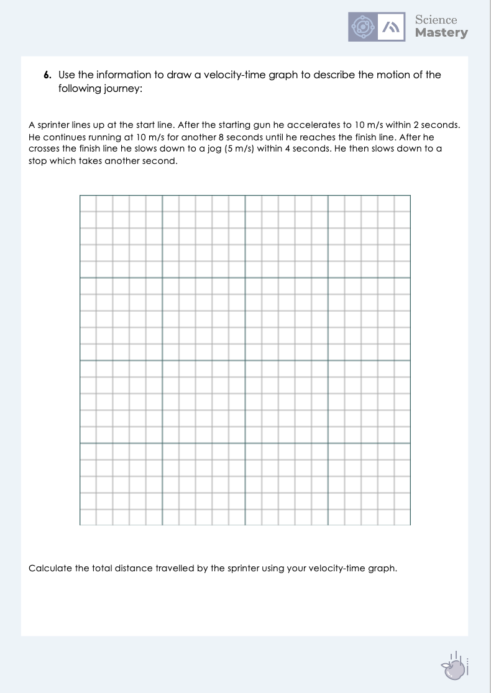
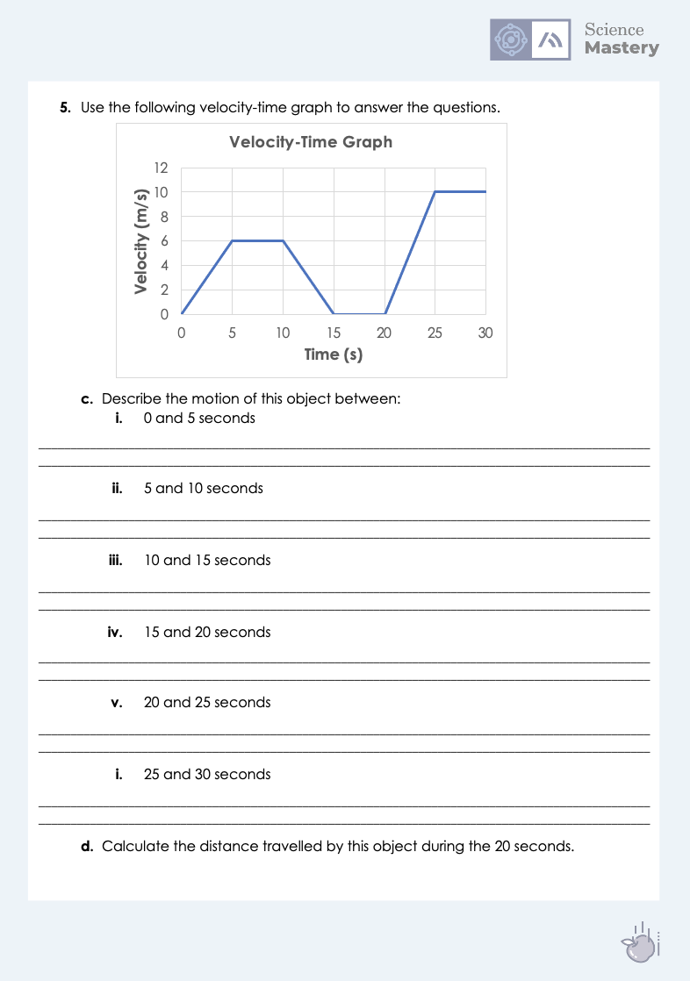
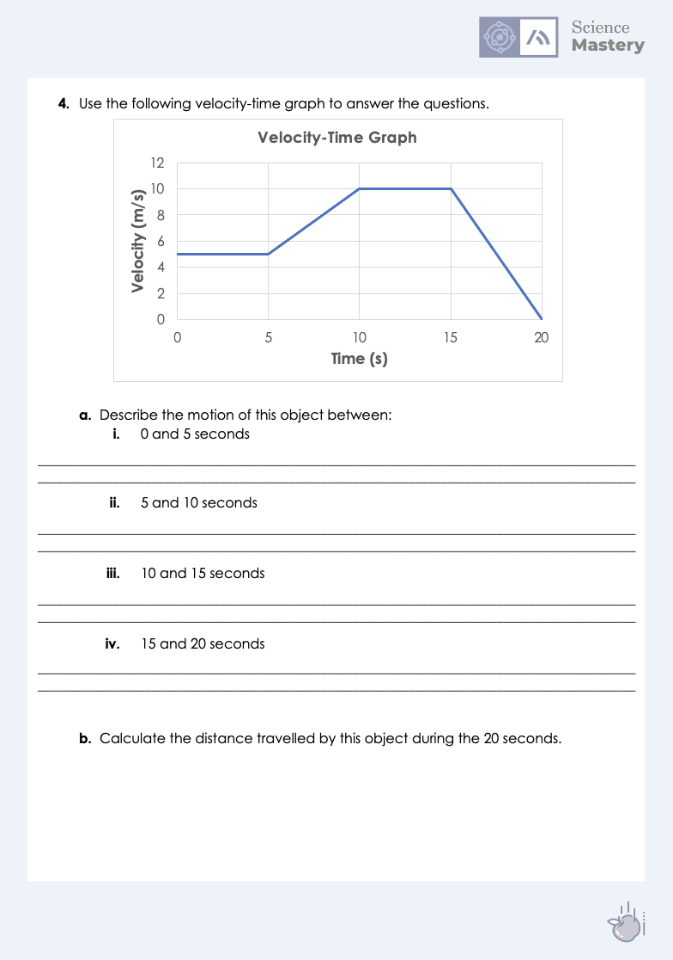
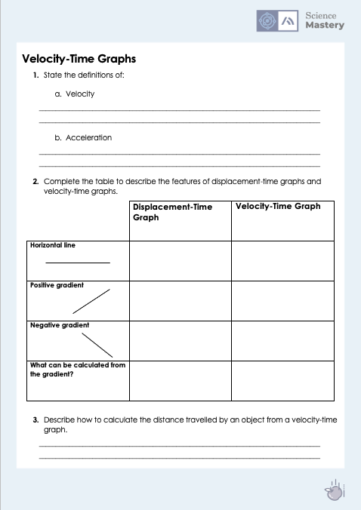
Velocity-Time Graphs
Complete the velocity-time graph activity.
Fill in the table to describe the differences between a displacement-time graph and a velocity-time graph.
Ensure you show working where necessary.
Use a ruler and pencil to draw your own velocity-time graph.
Notes:
Purpose: apply new information
For some pupils they may want to convert the description into a table format before putting it into the velocity-time graph. Some pupils may also need further support with planning the scale, or may be given a scaffolded version with the scale already written on.
Stretch – get pupils to write their own scenarios and draw velocity-time graphs.

Slide 19
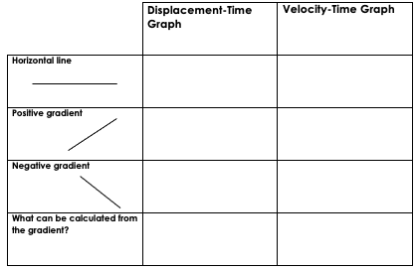
Answers
1a. The speed at which an object travels in a given direction.
1b. The rate of change of velocity.
Stationary object
Object with constant velocity
Constant speed
Constant acceleration (speeding up)
Returning to original position (travelling in opposite direction)
Constant deceleration (slowing down)
Speed
Acceleration

Slide 20
Answers
3. Distance travelled can be calculated by calculating the area under the graph.
4 ai. Object travelling at constant velocity
4 aii. Increasing velocity/acceleration
4 aiii. Constant velocity (higher than between 0 and 5 seconds)
4 aiv. Decreasing velocity/slowing down/deceleration (to a stop)
4b. Distance travelled = area under the graph
Area under the graph = (5 x 5) + (5 x 5) + (1/2 x 5 x 5) + (5 x 10) +( ½ x 5 x 10)
Area under the graph = 137.5 m

Slide 21
Answers
5 ai. Object accelerating/increasing velocity
5 aii. Constant velocity/no acceleration
5 aiii. Object decelerating/decreasing velocity
5 aiv. Object is stationary (velocity = 0 m/s)
5 av. Object accelerating/increasing velocity
5 avi. Constant velocity (higher than between 5 and 10 seconds)
5 b. Distance travelled = area under the graph
Area under the graph = (1/2 x 5 x 6) + (5 x 6) + (1/2 x 5 x 6) + (1/2 x 5 x 10) + (5 x 10)
Area under the graph = 135 m

Slide 22
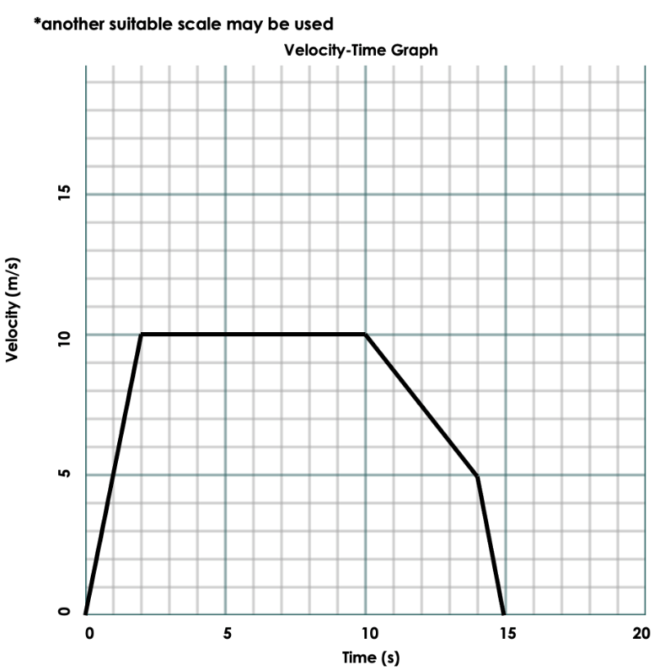
Answers
6.
Distance travelled = area under the graph
Area under the graph = (1/2 x 2 x 10) + (8 x 10) + (1/2 x 4 x 5) + (4 x 5) + (1/2 x 1 x 5)
Area under the graph = 122.5 m

Slide 23
Answer the questions below.
1. What does a horizontal line represent on a velocity-time graph?
A. Constant velocity
B. A stationary object
C. Increasing velocity
2. What can be calculated from the area under a velocity-time graph?
A. Distance travelled
B. Average velocity
C. Total time taken
3. What does a negative gradient represent on a velocity-time graph?
A. An object stopping
B. An object returning to its original position
C. An object slowing down
✓
✓
✓
Notes:
Suggested Guidance:
Q1. Answer: A
If students answer B they are not clear on the difference between velocity-time graphs and distance-time graphs. If students answer C they may have not understood the difference between the terms horizontal line and straight line. To fix-it pupils can summarise the meaning of features of both VT and DT graphs.
Q2. Answer: A
If students answer B or C they do not know the relationship between distance travelled and area under the graph. To fix-it, model again how to calculate the distance travelled. It may be worth explaining this in terms of velocity x time.
Q3. Answer: C
If students answer A they have assumed that a negative gradient always means an object that is stopping regardless of if it reaches the x axis. If students answer B they have not understood the differences between VT and DT graphs. To fix-it, students can annotate on a VT graph what is shown by each feature.

Slide 24
Lesson P3.1.9
What was good about this lesson? | What can we do to improve this lesson?
Send us your feedback by clicking this link
or by emailing sciencemastery@arkonline.org
Thank you!

